Slide 1
Rapid Coverage Survey of HIV Services among Key Populations
Data Collectors Training
Insert speakers’ name(s)
Insert speakers’ title(s)
Notes:
Instructions: Adapt this slide and the other slides in this presentation to suit the training participants and the situation. Green text on a slide should be tailored to the program’s particular concerns/circumstances.
The intended target audience for this training is people who will be involved in implementation of the survey including:
Program administrators
M&E staff
Interviewers
KP representatives
It may not be necessary for all of the implementers to attend all of the sessions; however, during sessions where roles and responsibilities are being discussed, the entire team should be present to ensure that everyone is aware of expectations.
There are instructions to guide activities and speaker notes for each slide. The speaker notes are not intended to be read verbatim! The notes are provided to give facilitators easy access to more detailed information should they need it during the presentation.
As appropriate for the audience, share printed and/or online copies of the Guideline for Conducting a Rapid Coverage Survey of HIV Services among Key Populations with participants to use as a reference during and after the workshop. During session 1, briefly introduce the sections of the guide and allow participants several minutes to explore the contents.
Prepare photocopies of the resources used in the training activities (e.g., consent, survey questionnaires, survey record sheet, effective interviewing techniques, interviewer checklist, etc.).

Slide 2
Training Objectives

Slide 3
Training Workshop Objectives
By the end of the training participants will be able to:
Explain why the rapid coverage survey (RCS) is useful to the program
Describe the locations and key population (KP) groups to be surveyed
Define informed consent and demonstrate use of the survey consent form
Demonstrate use of the survey tools
Describe the roles and responsibilities of interviewers, timelines, study logistics, and data management
Describe the purpose of supporting documentation and survey tools
Notes:
Note: These are sample learning objectives that address the knowledge and skills required for data collectors; adjust as needed for your program.

Slide 4
Sample Training Workshop Agenda
Day 1 (Introduction and Overview)
Welcome | Introductions/greetings Review objectives, ground rules
Session 1 | Rapid coverage survey overview/benefits
Session 2 | Survey locations and participants
Session 3 | Informed consent overview
Session 4 | Questionnaire overview Demonstration and practice interviews
Closing | Feedback/Questions
Day 2 (Demonstration, Practice, Planning)
Recap | Day one
Session 4 | Practice interviews (continued) Paper and tablets
Session 5 | Roles and responsibilities Conducting the survey
Session 6 | Supporting documentation and tools
Wrap-up | Feedback/Questions
Notes:
Instructions: Use the agenda* to describe how the workshop will be conducted with a focus on how the sessions will guide participants to learn and practice new skills.
* This is a sample agenda. Create an agenda that suits the needs of the participants and the logistics of your situation (e.g., include the time of day that a session will be conducted, add breaks). Distribute or post the agenda where participants can reference it throughout the workshop.

Slide 5
Session 1 Objective
Objective:
Explain why the rapid coverage survey (RCS) is useful to the program
Notes:
Instructions: Review the session objective with the participants. Ask if there are any questions.

Slide 6
What is a rapid coverage survey (RCS)?
A survey conducted for program purposes to understand key populations (KPs) access to HIV prevention services and other information.
Benefits:
Helps track progress toward program targets
Simple and inexpensive; integrated into routine program work; potential to be conducted annually at selected hot spots
Identifies gaps in services or outreach to help improve interventions
Facilitates monitoring of minimum package of services for KPs as per global WHO guidance
During a survey a team of trained interviewers conducts interviews with people to get their views and perspectives and document their experiences.
The RCS survey gathers information on KPs’ experiences with HIV prevention services.
Notes:
Explain: The RCS provides program managers with a way to assess reach and coverage of interventions targeting KP individuals. This can lead to better understanding of coverage with the minimum package of services and reaching UNAIDS 95-95-95 targets. This approach expands measurement of coverage beyond routinely collected program data.
The survey is rapid, simple, and inexpensive but robust and is designed to be implemented by the community-based organization (CBO)/nongovernmental organization (NGO) within its programmatic area. The survey is conducted by interviewers, often peer outreach workers, at a randomly selected sample of hot spots and is recommended to be repeated annually. The results are likely to be representative of KPs in the program.
The survey is designed to be integrated into routine programmatic work, using existing resources of people (staff and peer outreach workers) and skills. If properly coordinated, survey data from multiple programs can be pooled to provide program implementers and managers at the subnational or national levels with a more detailed picture of coverage.

Slide 7
Benefits of RCS
How can the RCS help the program do a better job of providing services to KPs?
Helps assess the extent to which HIV prevention needs of KPs are being met
Facilitates identifying gaps and better understanding changes to what services KPs are receiving through the program
Provides information (when done annually) to gauge program reach and make adjustments
Provides measures of information that may not be available with other program reporting (e.g., reported levels of condom use, PrEP adherence, and experiences of violence)
Notes:
Explain: In addition to helping gauge progress toward the UNAIDS 95-95-95 targets, the RCS measures the extent to which HIV prevention and other health needs of KPs are being met as stated in national guidelines.
By repeating the survey each year, you will be able to see the impact of your work, identify any gaps in the program, and understand better the changes happening within your program area.
The survey is designed to provide information for you. The information will be used only to gauge the impact of programs, not to evaluate program performance or make comparisons with other CBOs/NGOs.
This survey gives you a measure of coverage to compare with program data. It provides information that you may not get with program data—such as reported levels of condom use, PrEP adherence, and experiences of violence.

Slide 8
World Health Organization (WHO) 2022 guidance on minimum service package for KPs
Minimum Services Package for KPs
Access to condoms and lubricants
Harm reduction interventions
Behavioral interventions
HIV testing and counseling
Access to PrEP
HIV treatment and care for those who are positive
Prevention and management of viral hepatitis, STI screening and treatment, tuberculosis (TB), and mental health conditions
Sexual and reproductive health (SRH) interventions
Interventions for addressing violence
WHO minimum service package describes the services all KPs should be provided for HIV prevention.
These are the services we will be asking people about in the survey.
Source: Consolidated guidelines on HIV, viral hepatitis and STI prevention, diagnosis, treatment and care for key populations, Geneva: WHO, 2022.
Notes:
Explain: WHO has issued global guidance on the package of services that should be provided to KPs as listed on this slide.

Slide 9
RCS helps program planners understand:
Proportion of KPs being reached at hot spots in target areas
Coverage of KP members by each service in the minimum package
KP members’ access to and use of prevention products
Services needed by KP members, and how they would like to receive them
Proportion of KP members aware of their HIV/viral suppression status
Proportion of KP members report experiencing stigma, discrimination, or violence
Proportion of KP members who report being diagnosed with an STI
Notes:
Explain: An RCS measures a program’s effectiveness by providing a more complete picture of overall progress toward program goals. Specifically:
Proportion of KPs being reached at hot spots in your target areas
How well individual KP members are covered by each service in the minimum package
KP members’ access to and use of prevention products
Services needed by KP members, and how they would like to receive them
Proportion of KPs report being aware of their HIV or viral suppression status
Proportion of KP members report experiencing stigma, discrimination, or violence
Proportion of KP members report being diagnosed with an STI

Slide 10
Session 2 Objective
Describe the locations and KP population groups to be surveyed

Slide 11
Survey logistics: Where and with whom
Briefly describe the program that forms the basis of the survey’s KP population
Describe the geographic location
Describe the intervention
Share hot spot mapping results (if available)
Describe who the program reaches or works with
Share targets and progress toward targets (if relevant)
Notes:
Instructions: Text in green should be written by program managers to describe the program conducting the RCS. Share additional details if available and relevant.

Slide 12
Survey logistics: Selecting participants
Survey uses sampling
Sampling means selecting a smaller number of people or places to represent the whole
Hot spots are randomly selected
This reduces risk that the selection of hot spots favors one type or certain hotspot over another
All KP community members who consent to be interviewed will be interviewed
Information required for survey sampling:
Total number of KP community members in survey area
Estimated number of KPs per hot spot
Number of hot spots to be visited
Notes:
Instructions: Describe in lay terms how sampling works and how the hot spots are selected at random to reduce the risk of bias.

Slide 13
Session 3 Objective
Define informed consent and demonstrate use of the survey consent form
Notes:
Instructions: Review the session objective with the participants. Ask if there are any questions.

Slide 14
Research and survey ethics
This survey is NOT designed to be research; it is only for program purposes. However, as an assessment we adhere to principles of research ethics.
These are broadly based on humanistic principles that apply to programs as well as research.
Three principles underlying research ethics:
Respect for people
Beneficence (show kindness)
Justice
Notes:
Instructions: Review the information on the slide with the participants. Ask if there are any questions.

Slide 15
RCS ethical considerations
Confidentiality/privacy
Anonymity
Informed consent
Beneficence (show kindness)
Avoid pressuring individuals to participate
Provide information (RCS purpose, how results will be used)
Transparency (share how data will be reported/used)
Be respectful of KP individuals and communities
Protect participants
Notes:
Explain: Although formal approval from the local institutional review board may not be required for an RCS survey, there are ethical considerations that must be taken into account.
Ask: What ethical considerations should be taken into account in the design and implementation of the RCS to ensure that the rights and dignity of the KP individuals and communities are protected?
Solicit responses from several participants; click the mouse to advance the slide.
Explain: While these ethical considerations are critically important to uphold during the interviews with KP individuals, they should be maintained throughout the process when meeting with KP community members to plan the survey and share the results.

Slide 16
Informed consent
Informed consent is tied to the principle of respect for people (providing sufficient information and respecting a person’s choice to be part of the process or not)
To do so, it is important to:
Provide all relevant information about the survey
Confirm that the participant understands the information
Confirm that the participant is voluntarily participating
You can use usual techniques to confirm that people understand content in the informed consent process:
Look at a person’s body language to assess understanding.
Stop and ask if they have any questions or ask if they have understood.
Notes:
Instructions: Review the information on the slide with the participants. Ask if there are any questions.

Slide 17
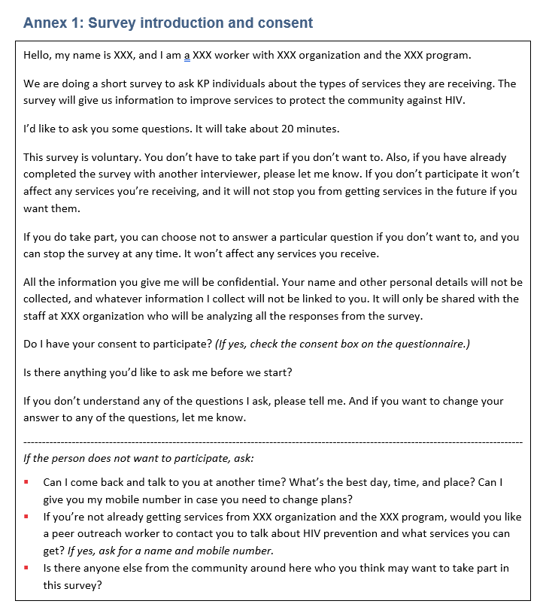
Survey introduction and consent
Script describes what to say to potential survey participants
Ensures all information is delivered to each participant in the same way
Supports informed decision-making
Can you recognize these parts of the informed consent – provide information, confirm understanding of the information, confirm voluntariness of participation?
Notes:
Explain: Before we dig into the process of conducting a survey, let’s review some of the resources and actual questionnaires.
The first resource we’ll review is the survey introduction and consent script:
The script describes what to say about the survey so that potential survey participants can make an informed decision about whether they would like to participate
An interviewer can change the words they use but must clearly communicate each point
Obtaining consent is an important first step prior to conducting an interview and must be documented for each participant
Click the mouse to advance the slide and reveal the question.
Instructions:
Tell participants to locate the survey introduction and consent script in the Guideline for Rapid Coverage Survey of HIV Services among Key Populations (Annex 1) or distribute photocopies of the script to each participant.
Ask two volunteers to take turns reading the items—one item at a time.
After the volunteer reads an item, ask: Would you say this differently; if so, how would you word this if you were talking to a KP member at a hot spot?
Note on a flip chart the word changes suggested by the group.
If a participant re-words the statement in a manner that changes the meaning, ask: Is there a way to say this clearly without changing the meaning; if so, how?
After completing each of the items, review each of the statements provided for “people who refuse to participate in the survey.”
Ask participants if they have any questions.

Slide 18
Session 4 Objective
Demonstrate use of the survey tools
Notes:
Instructions: Review the session objective with the participants. Ask if there are any questions.
In this session, the facilitators will use participatory facilitation, including role-plays, to introduce the relevant tools for the KP survey type(s). For example, for a survey that includes FSWs and MSM, the participants will explore both the FSWs and MSM interview form and skip the PWID form.

Slide 19
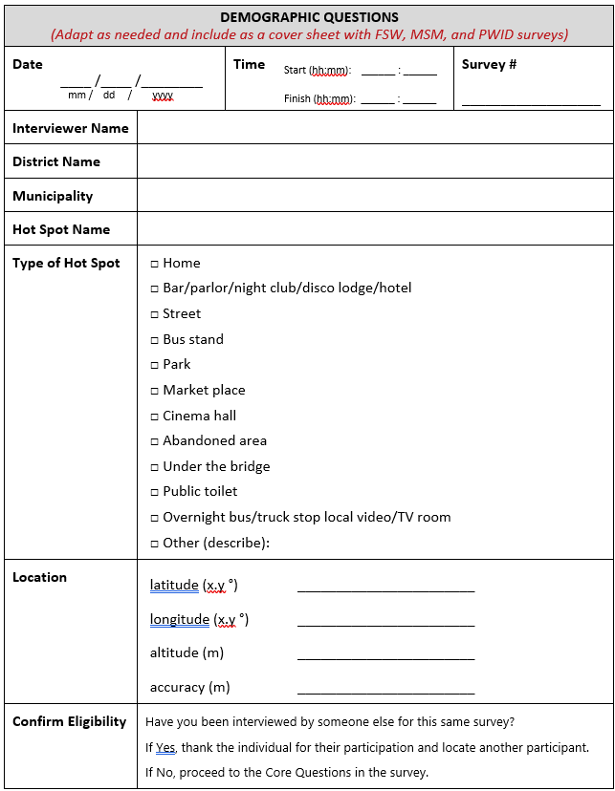
Demographic questions
Include with FSWs, MSM, and PWID surveys
Notes:
Explain: The demographic questions/items are to be included with FSWs, MSM, and PWID surveys. It can be found in Annex 2 of the RCS guideline (or distribute a photocopy of that page).

Slide 20
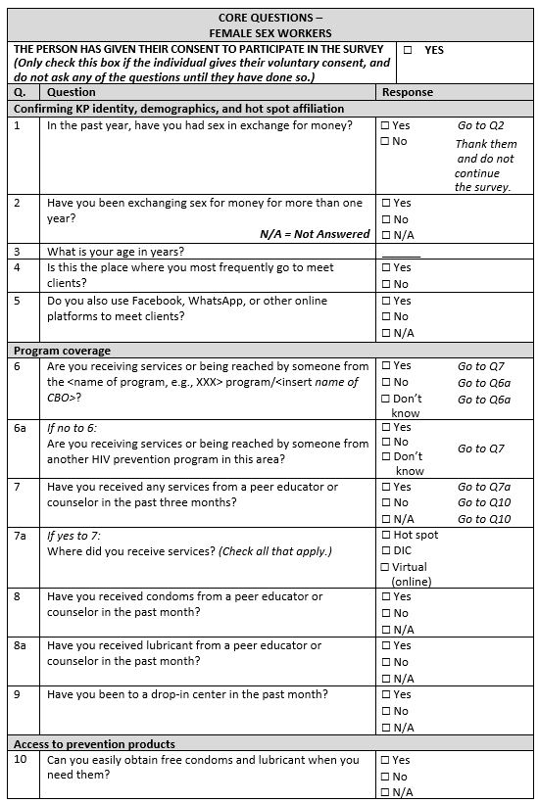
Questionnaire for FSWs
Items specific to FSWs grouped in 10 sections
Confirming KP identity, demographics, hot spot affiliation
Program coverage
Access to prevention products
Risk behaviors
Coverage of HIV testing
Coverage of ART (if reporting HIV positive)
Other medical services
Experience of stigma, discrimination, violence
HIV testing (omit if not including voluntary HIV testing in survey)
Referral to other KPs
Notes:
Explain: The questions/items in the survey are grouped into 10 sections. This is the first part of the questionnaire for female sex workers. It can be found in Annex 2 in the RCS guideline (or distribute a photocopy of the survey).

Slide 21
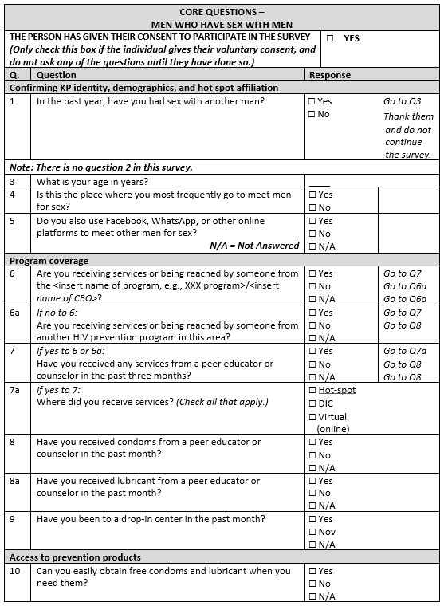
Questionnaire for MSM
Items specific to MSM grouped in 10 sections
Confirming KP identity, demographics, hot spot affiliation
Program coverage
Access to prevention products
Risk behaviors
Coverage of HIV testing
Coverage of ART (if reporting HIV positive)
Other medical services
Experience of stigma, discrimination, violence
HIV testing (omit if not including voluntary HIV testing in survey)
Referral to other KPs
Notes:
Explain: This is the questionnaire for men who have sex with men. The questions are very similar to the questions/items in the FSWs and PWID surveys and are grouped into 10 sections. It can be found in Annex 3 in the RCS guideline (or distribute a photocopy of the survey).

Slide 22
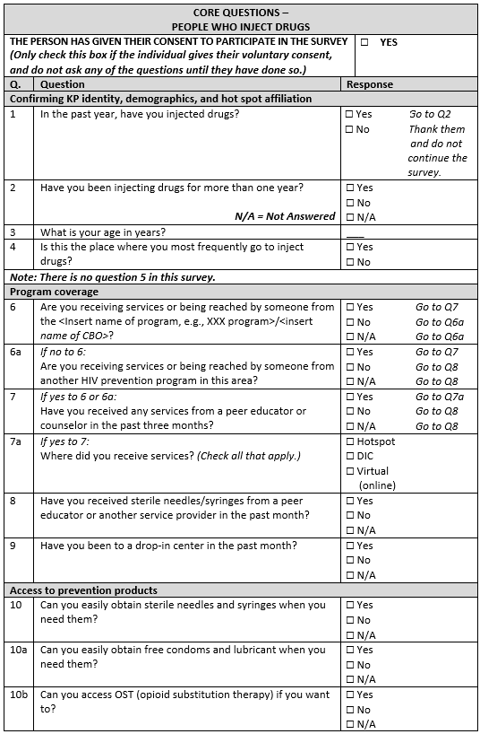
Questionnaire for PWID
Items specific to PWID grouped in 10 sections
Confirming KP identity, demographics, hot spot affiliation
Program coverage
Access to prevention products
Risk behaviors
Coverage of HIV testing
Coverage of ART (if reporting HIV positive)
Other medical services
Experience of stigma, discrimination, violence
HIV testing (omit if not including voluntary HIV testing in survey)
Referral to other KPs
Notes:
Explain: This is the questionnaire for people who inject drugs (PWID). The questions are very similar to the questions/items in the FSWs and MSM surveys and are grouped into 10 sections. It can be found in Annex 4 in the RCS guideline (or distribute a photocopy of the survey).

Slide 23
Review survey questions for understanding
Important that questions are understood by participants
Survey questions may be slightly changed to improve understanding, but
Interviewers should ask questions the same way each time
Would you say this differently; if so, how would you word this?
Notes:
Explain: As we did with the survey information and consent, we’re going to review the questions in each of the surveys to ensure all of the words/questions will be understood by the KPs being interviewed. If there is a better way to ask a question, we will make note of it and update the survey.
Instructions:
Tell participants to break into small groups of three to four individuals. Give each group a flip chart and markers.
Assign each group one of the survey types relevant to your program (FSWs, MSM, or PWID). Depending on the number of participants and types of KPs in the program, there may be more than one group for each type of survey.
Tell participants to carefully review each item in the survey that they have been assigned and determine whether the question is worded in a manner that will be understood by a member of that KP group.
If they have suggestions/recommendations for improving the clarity of an item, write the suggestion on the flip chart and be prepared to present and discuss it with participants from the other groups. It’s not necessary to change items that are clear.
After 15-20 minutes, call the groups together.
Ask each group to present their recommendations. If another group has already made the same suggestion, note it quickly and move on.
After all the groups have presented, summarize the changes that have been suggested. Note any suggestions that change the meaning, ask: Is there a way to say this clearly without changing the meaning; if so, how?

Slide 24
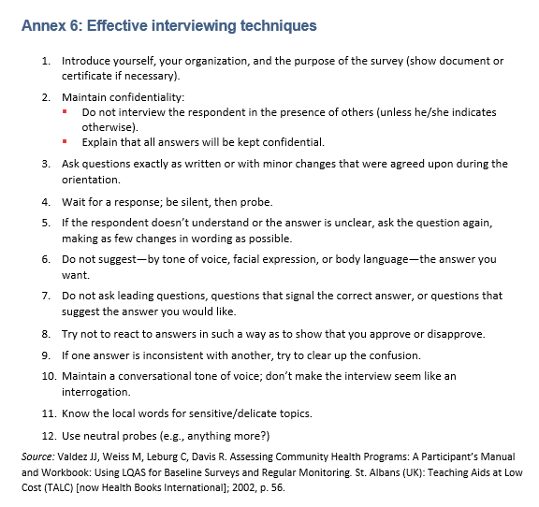
Effective interviewing techniques
Follow these interviewing techniques to ensure most effective results and usefulness of the survey.
Notes:
Speaker Notes: For the survey to provide useful information, it’s very important that it be administered consistently. Interviewers must ask the same questions of each KP member. These suggestions for conducting effective interviews are found in the Guideline for Conducting a Rapid Coverage Survey of HIV Services among Key Populations (Annex 6).
Instructions: Ask participants to take turns reading each guideline aloud. Discuss each one as needed to ensure that it is understood; solicit or provide examples as needed.
Introduce yourself, your organization, and the purpose of the survey (show document or certificate if necessary).
Maintain confidentiality: Do not interview the respondent in the presence of others (unless he/she indicates otherwise). Explain that all answers will be kept confidential.
Ask questions exactly as written or with minor changes that were agreed upon during the orientation.
Wait for a response; be silent, then probe.
If the respondent doesn’t understand or the answer is unclear, ask the question again, making as few changes in wording as possible.
Do not suggest—by tone of voice, facial expression, or body language—the answer you want.
Do not ask leading questions, questions that signal the correct answer, or questions that suggest the answer you would like.
Try not to react to answers in such a way as to show that you approve or disapprove.
If one answer is inconsistent with another, try to clear up the confusion.
Maintain a conversational tone of voice; don’t make the interview seem like an interrogation.
Know the local words for sensitive/delicate topics.
Use neutral probes (e.g., anything more?)

Slide 25
Practice interviews
Observe facilitator demonstration
Break into pairs or groups of three (if using observers)
Role-play the parts of interviewer and person being interviewed
Use resources in your packet as though doing an actual interview
Follow the steps in the process checklist (Annex 7)
Adhere to the advice for conducting an effective interview
Switch roles until each person has used each type of questionnaire alternating between paper and a tablet
Notes:
Instructions: Facilitators should demonstrate for participants how to conduct an interview carefully following all the standard procedures and using the resources provided in the interviewer packet.
Ask participants to break into groups of two or three participants. In groups of three, the third individual observes the interview and provides constructive feedback to the person playing the role of the interviewer.
Switch roles until each person has played the role of the interviewer one time. Call the pairs/groups together and discuss issues and observations.
While participants are practicing interviews, facilitators should circulate through the pairs/groups and observe the interactions. Provide constructive feedback as appropriate to ensure that the participants are performing as expected.
Ask:
Was there anything about the consent script that was challenging?
How did it feel conducting the interview? Were you able to follow the guidelines for conducting an effective interview?
Were there particular questions that were confusing or uncomfortable to ask?
Did the tablet work as expected? –while documenting responses? –while uploading data?
After the discussion, resume practicing interviews until each participant has had an opportunity to try another questionnaire. Conduct another discussion using the questions above again. Continue this pattern until each participant has had an opportunity to practice conducting 4 to 5 interviews.

Slide 26
Session 5 Objective
Describe the roles and responsibilities of interviewers, timelines, study logistics, and data management
Notes:
Instructions: Review the session objective with the participants. Ask if there are any questions.
Prior to the training, adapt these slides according to the survey plans.

Slide 27
Steps for conducting an RCS
Collaborate with KP community
Decide which KP type to survey
Choose dates
Calculate how many KPs and hot spots
Randomly select hot spots
Adapt survey tools
Choose interviewers to conduct survey
Conduct orientation for the interviewers
Conduct the survey
Analyze results
Share results and get feedback
Discuss lessons learned for next survey
We are here
Notes:
Explain: Program administrators and staff have completed all the steps you see listed in the Planning stage. You were selected as interviewers, and we are here now in the “prepare” step conducting the orientation for you. In this session, we will review the timeline and logistics for the implementation step.

Slide 28
Roles and Responsibilities Interviewers
Successfully complete orientation/training
Obtain interviewer packet
Travel to hot spot on assigned days/times
Identify KP individuals/survey participants
Locate private spaces for conducting interview
Conduct interviews (process checklist/job aid)
Return completed questionnaires and survey record sheet daily
Provide feedback about issues/concerns
Notes:
Explain: Here are the typical roles and responsibilities of interviewers.
Discuss: Agree whether there are additional roles and responsibilities that should be included for interviewers. Update the RCS roles and responsibilities list to include any changes and ensure that everyone participating in the RCS is clear about their roles/responsibilities and the roles/responsibilities of others on the team.

Slide 29
Roles and Responsibilities Community-based KP representatives
Participate in RCS training/orientation
Along with regular peer outreach workers, describe characteristics of hot spots
Accompany interviewers or M&E implementation monitors to hot spot and provide introductions to hot spot owner
Introduce interviewers to FSWs/MSM individuals who may be interested in participating in the survey (if needed)
Inform members of the KP community about the RCS
Notes:
Explain: Here are the typical roles and responsibilities of community-based KP representatives.
Ask: Are there any additional RCS-related roles and responsibilities that could be assigned to KP representatives?
Discuss: Agree whether there are additional roles and responsibilities that should be included for KP representatives. Update the RCS roles and responsibilities list to include any changes and ensure that everyone participating in the RCS is clear about their roles/responsibilities and the roles/responsibilities of others on the team.

Slide 30
Roles and Responsibilities Survey supervisors/coordinators
Provide general administrative and logistics support/resources (ID cards, travel/expense authorizations, tablets, printing, etc.)
Assign interviewers to hot spots
Compile interviewer packets
Daily update with each interviewer in person (or via cell for tablets):
Number of interviews (completed/KPs approached)
Challenges/solutions
Review automated data entries (or paper forms) daily
Conduct four to five field visits to monitor survey implementation
Notes:
Explain: Here are the typical roles and responsibilities of survey supervisors/coordinators.
Ask: Are there any additional RCS-related roles and responsibilities that could be assigned to survey supervisors/coordinators?
Discuss: Agree whether there are additional roles and responsibilities that should be included for survey supervisors/coordinators. Update the RCS roles and responsibilities list to include any changes and ensure that everyone participating in the RCS is clear about their roles/responsibilities and the roles/responsibilities of others on the team.

Slide 31
Conducting the survey
The survey will be conducted in xx and yy locations from date–date.
Teams of at least two interviewers will go out to hot spots (not the hot spots they currently work in)
After you arrive at the assigned hotspots:
Approach all KPs present at the hotspot
Read the informed consent statement and comply with participant’s decision to participate or not
Find a place with privacy (where you will not be seen or heard) to conduct the interview for those who agree to participate
You will be entering responses to survey interviews on a tablet which is pre-programmed with the questionnaire
Notes:
Instructions: Text in green font should be written by program managers. Share additional details if available and relevant.

Slide 32
Uploading survey data from tablets
Insert detailed instructions of the process here and provide a copy to participants to reference when conducting the survey
Using the data collected on the tablets during practice interviews, participants will connect to Wi-Fi and sync the data files.
Notes:
Instructions: Facilitators should review the step-by-step instructions and demonstrate for participants how to upload the data from the tablet.
After the demonstration, ask participants to upload the data from the sample interviews that they conducted. Ensure that the interviewer packet includes a copy of the instructions.
Ask:
Was there anything about the process that was challenging?
Were you able to follow the instructions?
Did the tablet work as expected?

Slide 33
Reminders about survey process
There are no incentives for participating in the survey.
Transport to hot spots will be provided via prearranged transportation OR will be reimbursed for transportation with a receipt.
HIV testing will not be provided as part of this survey, but referrals to services should be. (List the steps associated with the referral to testing service.)
Notes:
Instructions: Text in green font should be tailored to the program specifications.

Slide 34
Session 6 Objective
Describe the purpose of supporting documentation and tools available for the survey
Notes:
Instructions: Review the objective of session 6 with the participants. Ask if there are any questions.

Slide 35
Checklist of materials for interviewers
Map of the hot spot(s) and directions
A form of ID to show they are part of the XXX program
Survey introduction and consent script
Questionnaires (FSWs, MSM, PWID) – enough response forms for all enrolled KP individuals and estimated number of non-enrolled
Tablets pre-loaded with the questionnaire(s)
Survey record sheet
Pens
Cell phone
Supervisor’s name and phone number
Cash for transportation to and from the hot spot, if needed
Referral forms for HIV counseling/testing
Notes:
Distribute interviewer packets to each participant.
Explain: Check your packet of materials to be sure you have everything on this list.
Materials Checklist for Interviewers
Map of the hot spot(s) and directions
A form of ID to show they are part of the XXX program
Survey introduction and consent script
Questionnaires (FSWs, MSM, PWID) – enough response forms for all enrolled KP individuals and estimated number of non-enrolled
Tablets pre-loaded with the questionnaire(s) – paper forms should also be supplied in the event there are problems with the tablets
Survey record sheet
Pens
Cell phone
Supervisor’s name and phone number
Cash for transportation to and from the hot spot, if needed
Referral forms for HIV counseling/testing
Ask: Do you have any questions about any of the materials in your packet?

Slide 36
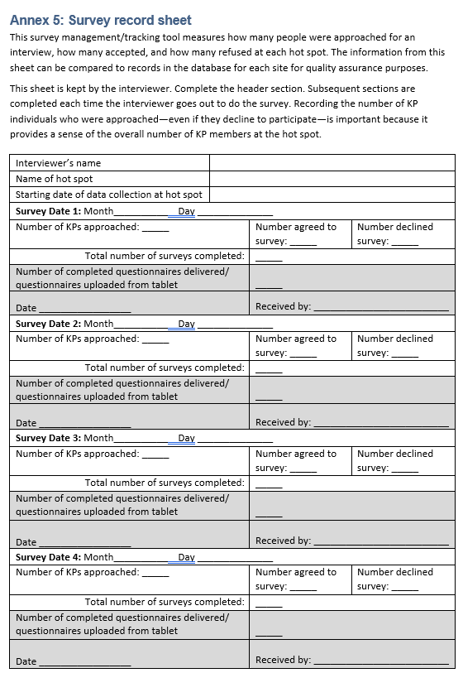
Survey record sheet
Fill this form every day to summarize what occurred
Share the summary with the survey supervisor during your daily check-in
Notes:
Explain: Retrieve the survey record sheet from your packet.
Ask: Would someone like to volunteer to read the instructions at the top of the form?
Explain: Now we will complete the header information at the top of the form. Write your name, the hot spot that you have been assigned, and the starting date for data collection at the hot spot.
For each day that you conduct the survey, complete one of the Survey Date text boxes including the number of KPs approached at that hot spot, the number who agreed to be surveyed, the number who declined, and the total number of surveys completed.
The boxes shaded in gray are to be completed by the survey supervisor during your daily check-in.

Slide 37
Wrap-up
Questions?
What remaining questions do you have about the process of conducting the survey?
Next steps
Facilitators to present the next steps in the survey
Facilitators to distribute survey materials, timeline, instructions, and contact information; and set timeline for next survey team check-in or communication
Notes:
Instructions: Tailor this slide to the program’s particular concerns/circumstances. Share available and relevant details.

Slide 38
THANK YOU!
Notes:
Thank you. If you have any questions, the floor is open for the discussion.

Slide 39
This work was made possible by the generous support of the American people through the United States Agency for International Development (USAID) and the U.S. President’s Emergency Plan for AIDS Relief (PEPFAR). The contents are the responsibility of the EpiC project and do not necessarily reflect the views of USAID, PEPFAR, or the United States Government. EpiC is a global cooperative agreement (7200AA19CA00002) led by FHI 360 with core partners Right to Care, Palladium International, and Population Services International (PSI).
Stay Connected
EpiC Twitter
EpiC Webpage
EpiC Facebook
EpiC YouTube
EpiC Blog

